Slide 1

I WILL GO WITH MY FAMILY
FAMILYMINISTRIES HOUR
EXODUS 10:8-11

Slide 2
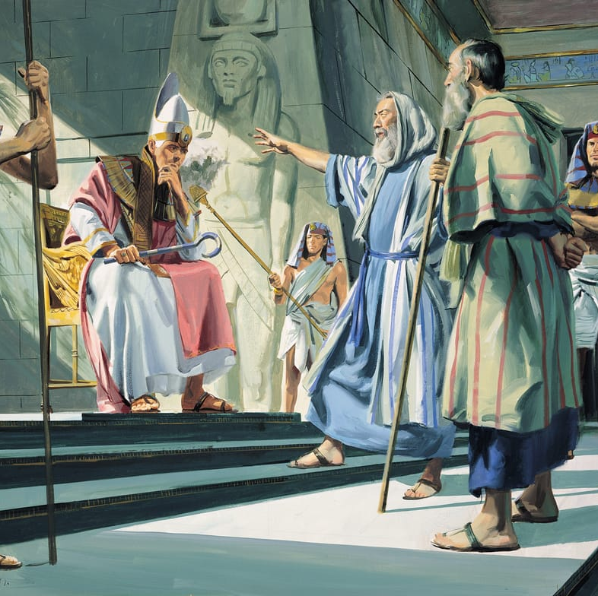
Now Moses had responded to God's call. He has gone to Egypt and has appeared before Pharaoh and has told him the message from God, “Let My people go”.

Slide 3
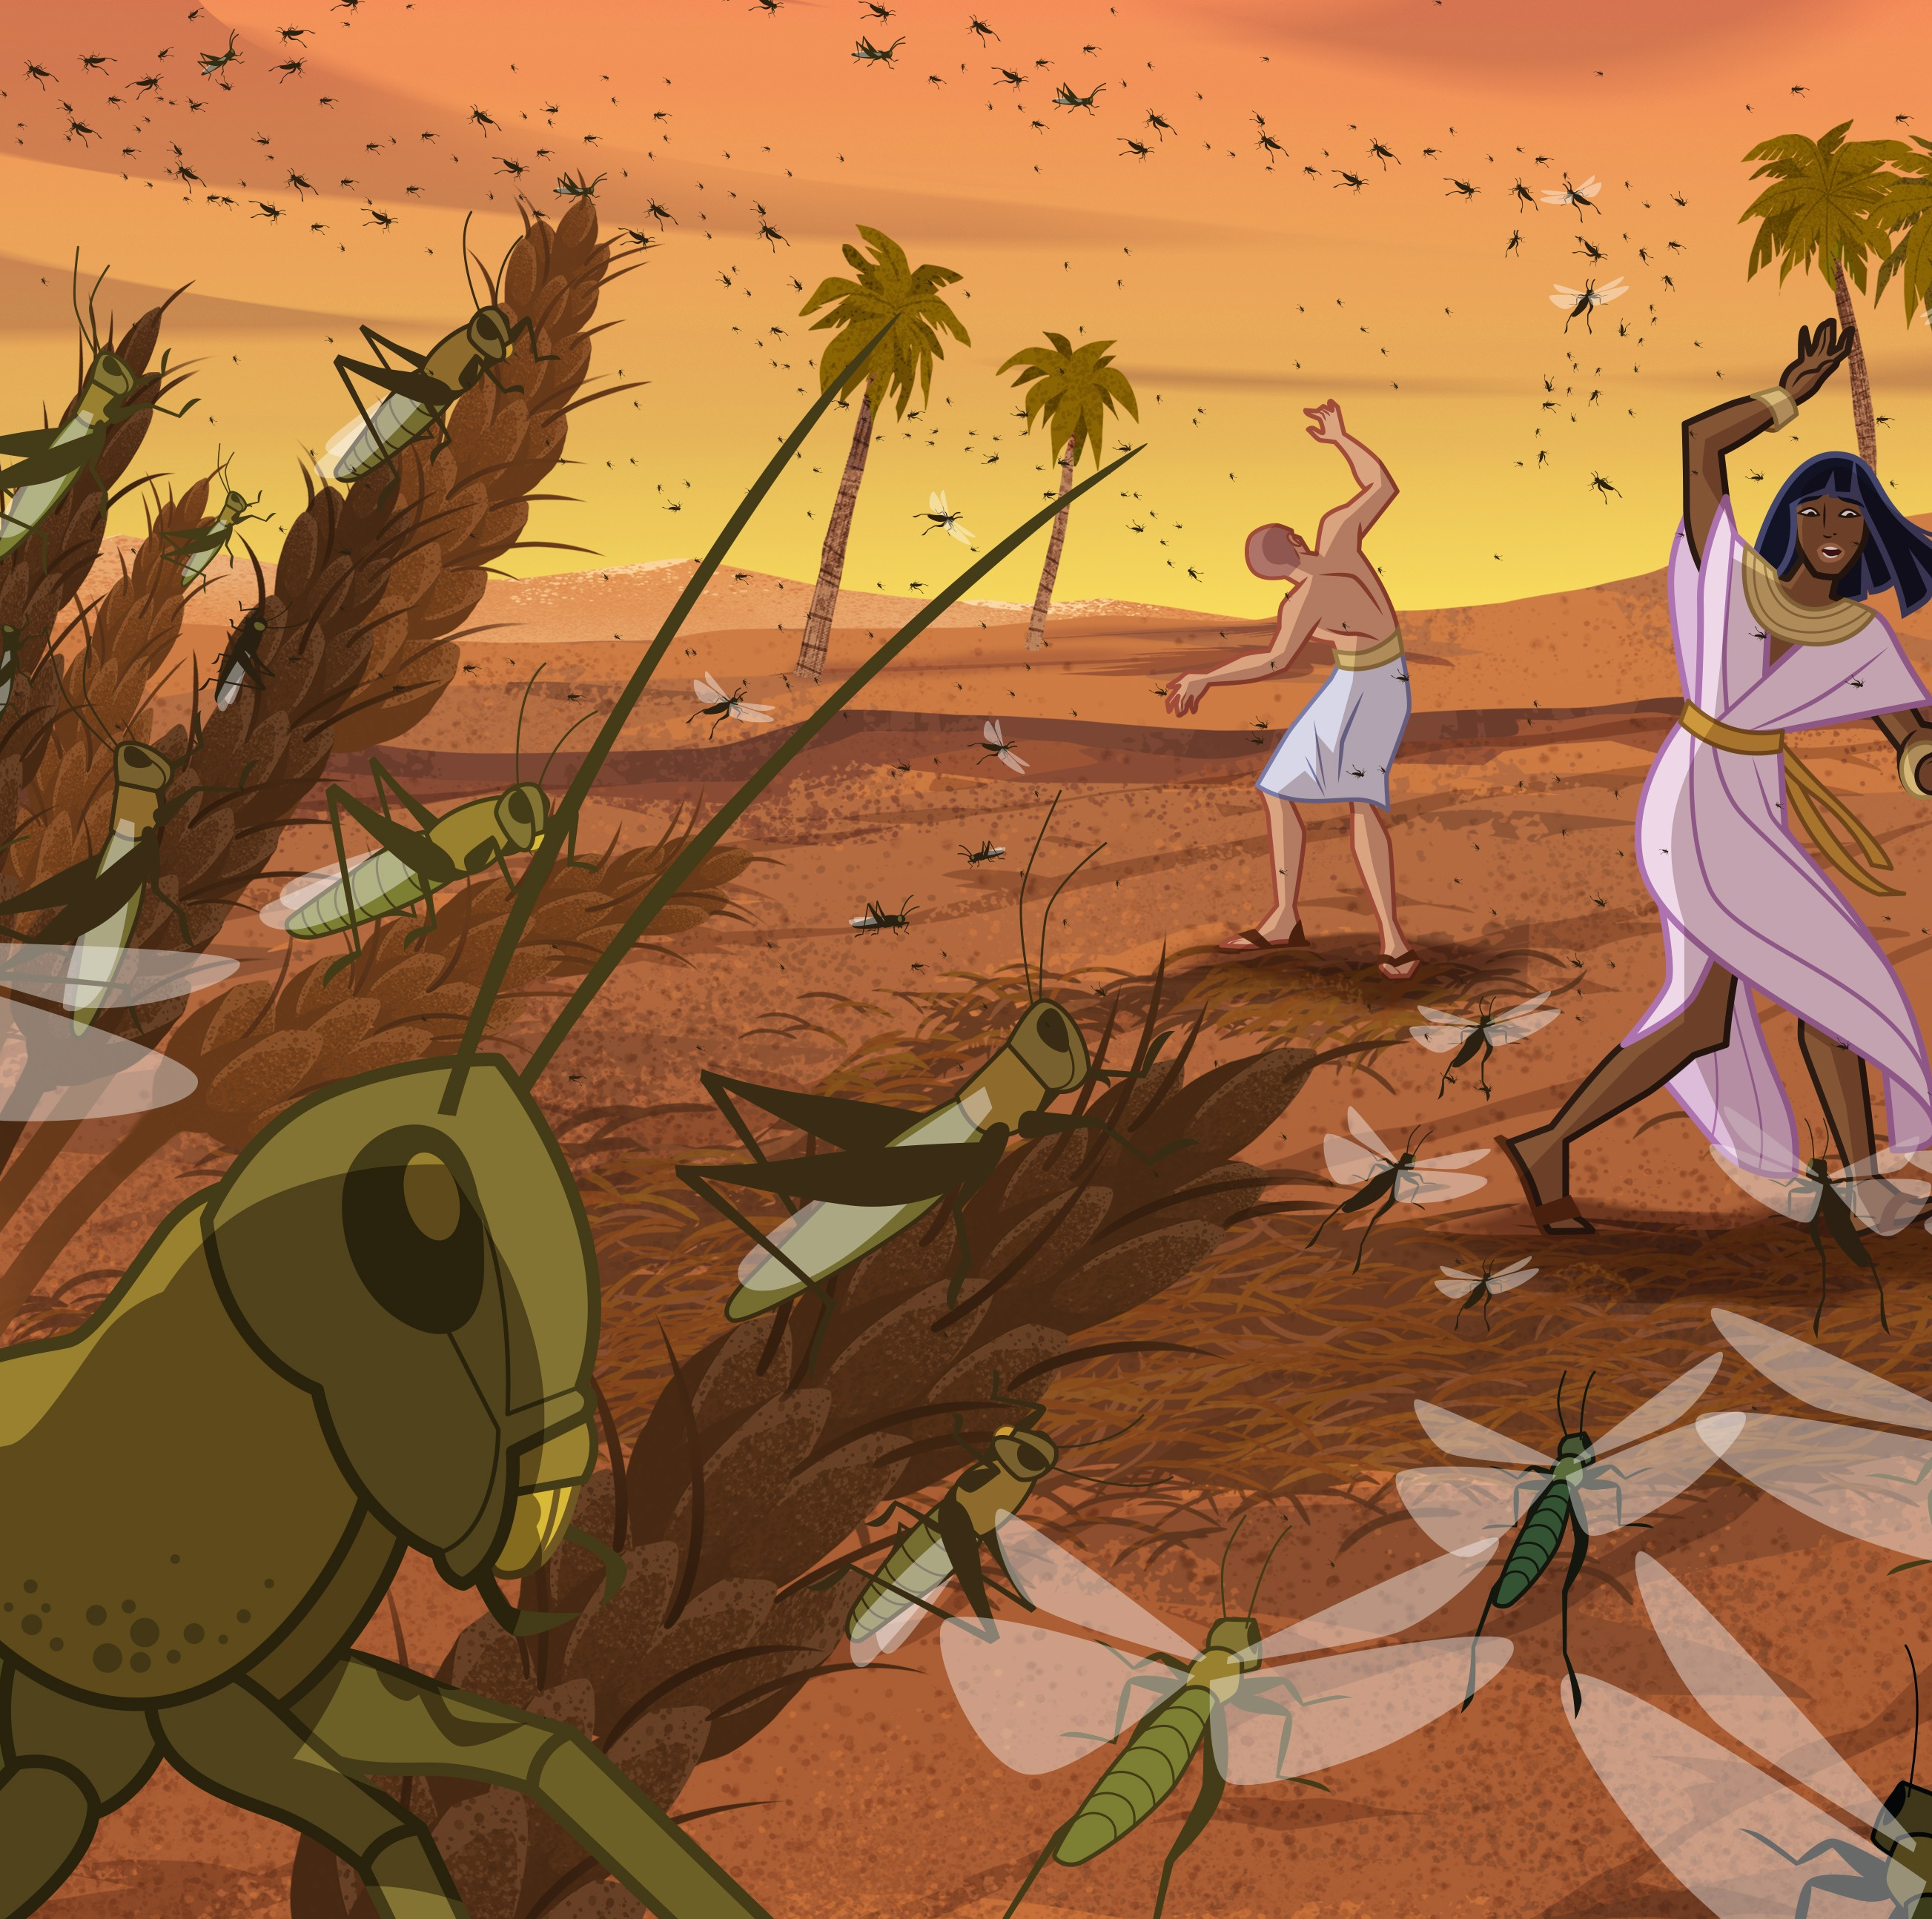
When Pharaoh refused to let the children of Israel go, then God took a hand, and proceeded to bring judgments, in the form of plagues, upon Egypt.
Notes:
The purpose of the plagues was to make Pharaoh and the Egyptians see that the God of Israel was stronger than the gods of Egypt. The plagues were ten in number and distributed over about a year. With the exception of the first and the last they were natural phenomena common to Egypt, the miraculous thing being that they came and went at the command of God and were of great severity as judgments against the gods of Egypt

Slide 4
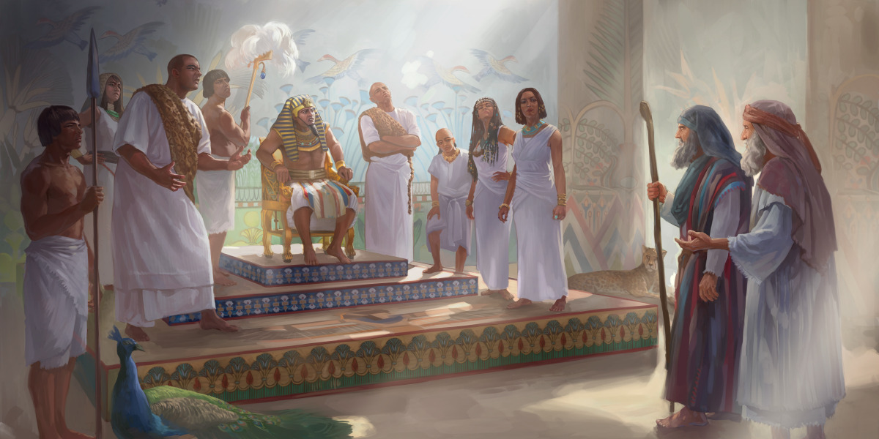
LET MY PEOPLE GO

Slide 5
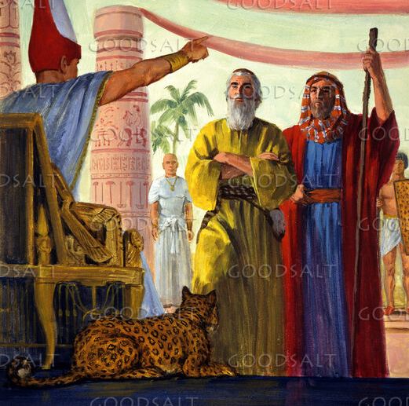
When Moses and Aaron appeared before Pharaoh they said, “Thus saith the Lord God of Israel, ‘Let my people go, that they may hold a feast unto me in the wilderness.’”

Slide 6
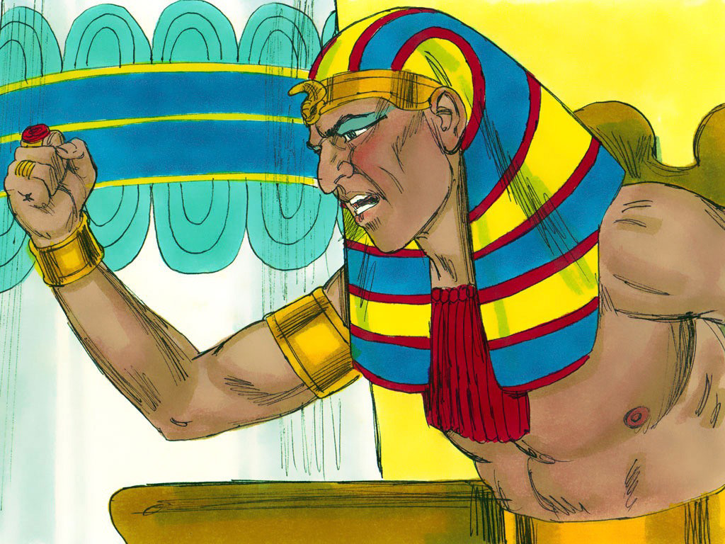
Pharaoh retorted, “Who is the Lord that I should obey His voice to let Israel go? I know not the Lord, neither will I let Israel go.” (Exod 5:1-2).
Then Moses and Aaron demanded that Pharaoh let Israel go a three days’ journey into the wilderness.
Notes:
Pharaoh again refused, and practically said, the service of God is a waste of time. He then increased the children of Israel's burdens. But when after the first three plagues there came the plague of flies upon the Egyptians only, Pharaoh thought it was time to compromise, so he sent for Moses and said, “Go ye, sacrifice to your God in the land.” (Exod 8:25).

Slide 7
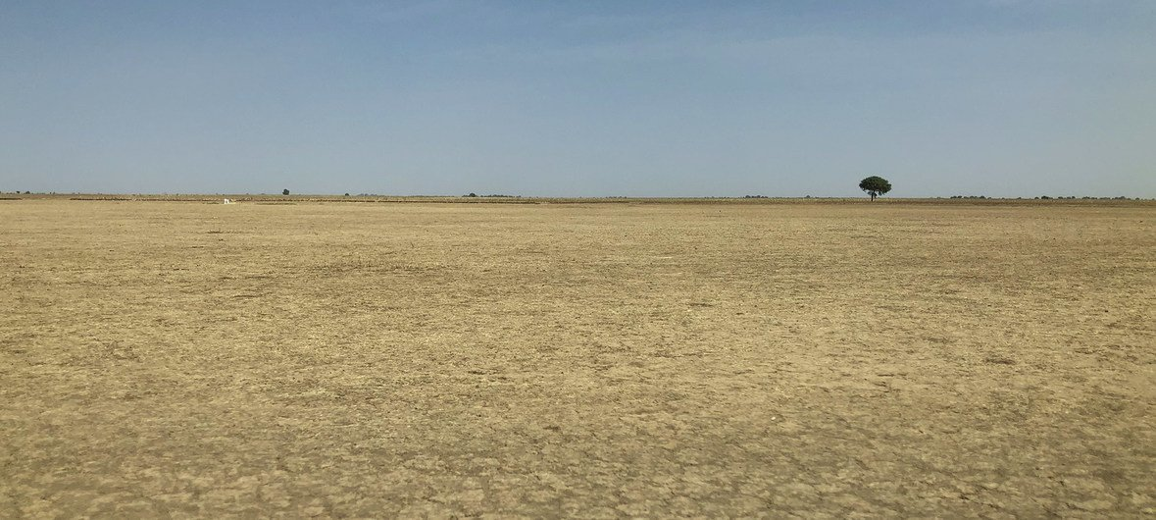
SACRIFICE IN THE LAND

Slide 8
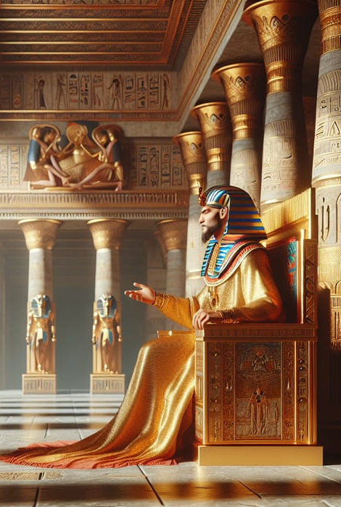
Pharaoh would not object to an occasional sacrifice “in the land” if that would make the children of Israel satisfied to remain in Egypt where he could retain his power over them.
So Satan does not object to an occasional “spasm” of religious endeavor as long as we still remain in the world.
(Exod 8:26).
Notes:
If Pharaoh’s advice had been followed the children of Israel would never have left Egypt.
To it Moses replied, “It is not meet so to do; for we shall sacrifice the ‘abomination of the Egyptians’ to the Lord our God . . . and they will stone us”

Slide 9
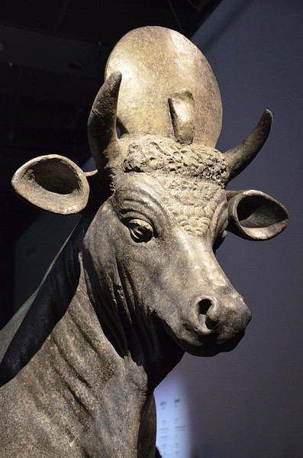
The sacred bull Apis, was one of the gods of Egypt, and if the children of Israel offered sacrifices of “bullocks” to Jehovah “in the land,” that would be an “abomination” to the Egyptians, and they would stone them for sacrificing the gods of Egypt.

Slide 10

This compromise means that a one cannot be a Christian and worship God “in the land” without offending the world.

Slide 11
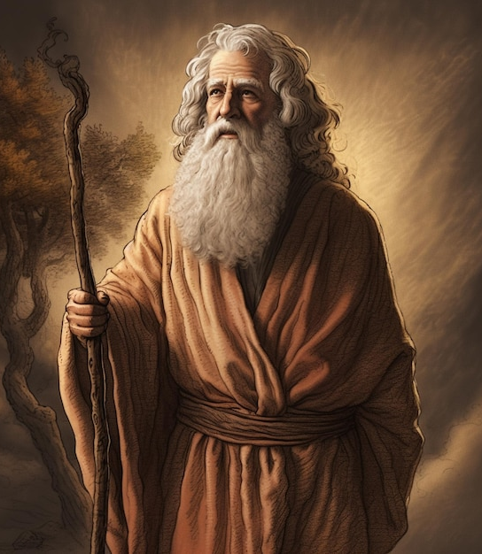
Moses refused to accede to Pharaoh's proposal, and said, “We will go three days' journey into the Wilderness, and sacrifice to the Lord our God, as He shall command us” (Exod 8:27), and, because the plague of flies was unendurable, Pharaoh proposed a second compromise.
“I will let you go, that ye may sacrifice to the Lord your God in the Wilderness; only ye shall not go ‘very far away’” (Exod 8:28).

Slide 12

Stand your ground, do not give in, and Satan will begin to bargain for a compromise.
Notes:
The lesson is, stand your ground, do not give in, and Satan will begin to bargain for a compromise. This second proposition or compromise is more dangerous than the first, for Pharaoh knew it would be easy to get Israel back if they did not go very far away. So Satan says, “Yes, become a professing Christian, join the Church, but do not go very far away, observe the Sabbath , but the rest of the week be back in Egypt (the World) enjoying its pleasures.”

Slide 13
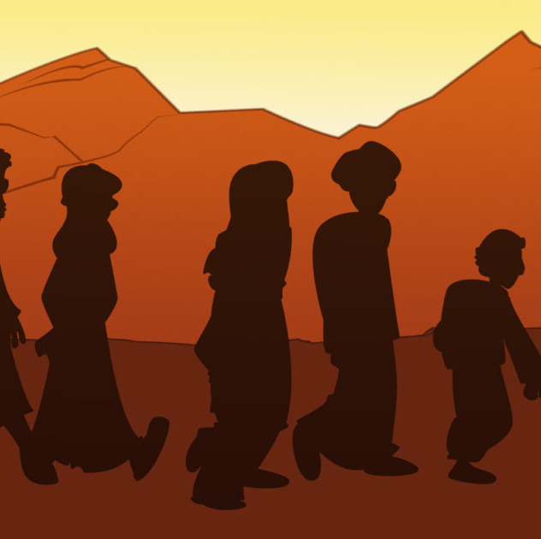
How could the children of Israel reach Canaan by going only three days journey into the Wilderness?
“Not very far away” is incompatible with a happy Christian life for it means a vacillating life. Let us beware of the creeping compromises that are gradually finding their way into our churches.

Slide 14
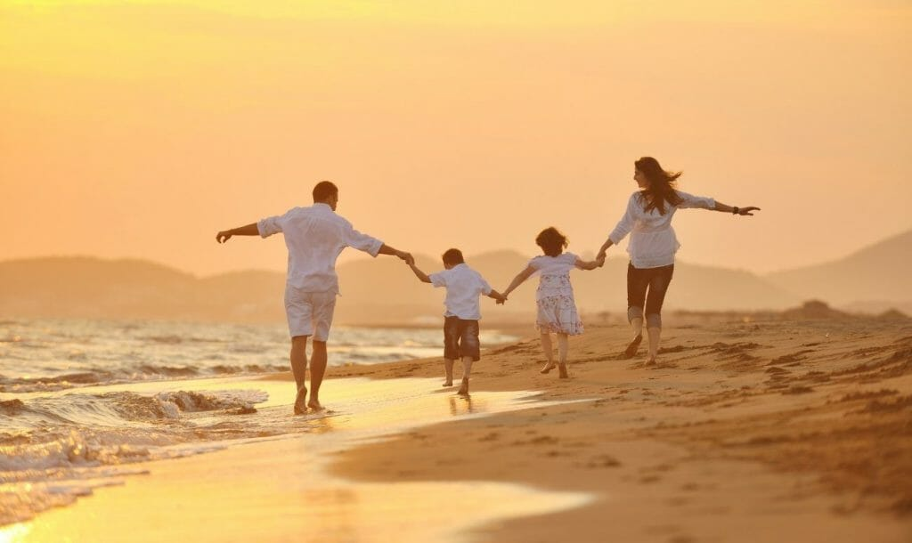
WE WILL GO WITH OUR FAMILIES

Slide 15
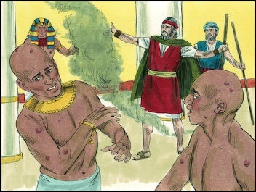
Between the second and third compromise there were the Plagues of Murrain, Boils and Hail.
Exodus 10:7
Exodus 10:9
Notes:
Then Pharaoh’s servants said unto him, “How long shall this man Moses be a snare unto us?...knowest thou not yet that Egypt is destroyed?” (Exod 10:7). Then Pharaoh sent for Moses and Aaron and said unto them “Go, serve the Lord your God, but who are they that shall go?” And Moses said, “We will go with our young, and with our old, with our sons and with our daughters, with our flocks and with our herds will we go; for we must hold a feast unto the lord” (Exod 10:9). They needed their flocks and herds for sacrifices. But Pharaoh said, "Not so; go now ye that are men." Pharaoh knew that if the men left their loved ones in Egypt it would not be long before they would be back.

Slide 16
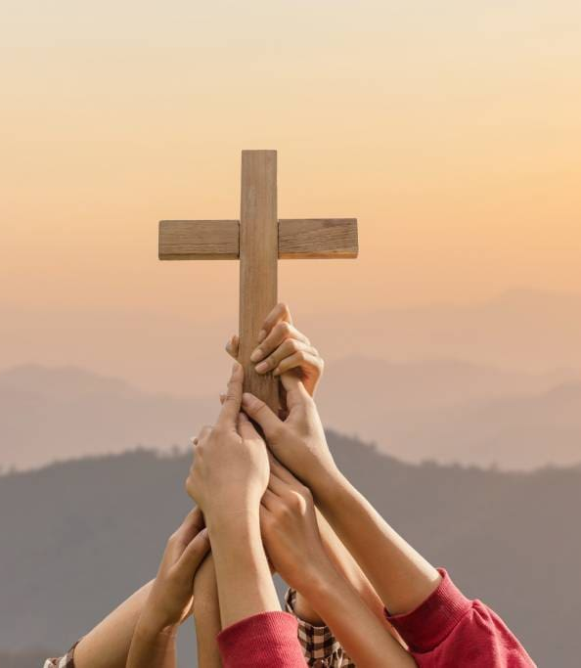
This compromise means let the older people become Christians if they want to, but do not force religion on the young.

Slide 17
Be a Christian if you want to, but do not force religion on your wife and children, for it is a personal matter. Let them enjoy their *Egyptian pleasures" and you show no concern as to their salvation. With the offer of this compromise Pharaoh drove Moses and Aaron away.

Slide 18
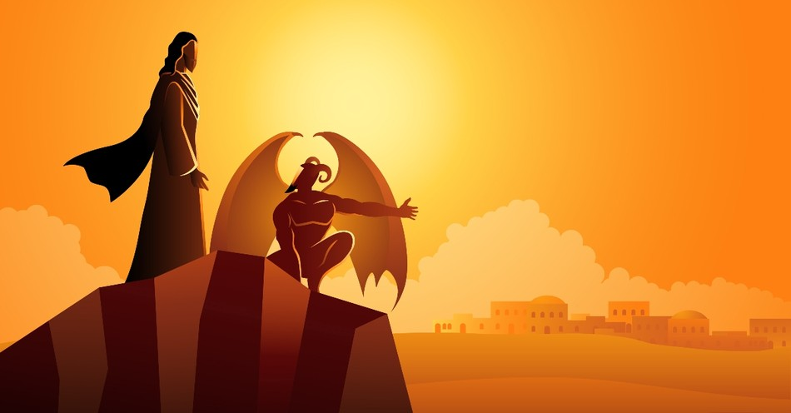
Satan’s Taskmasters

Slide 19
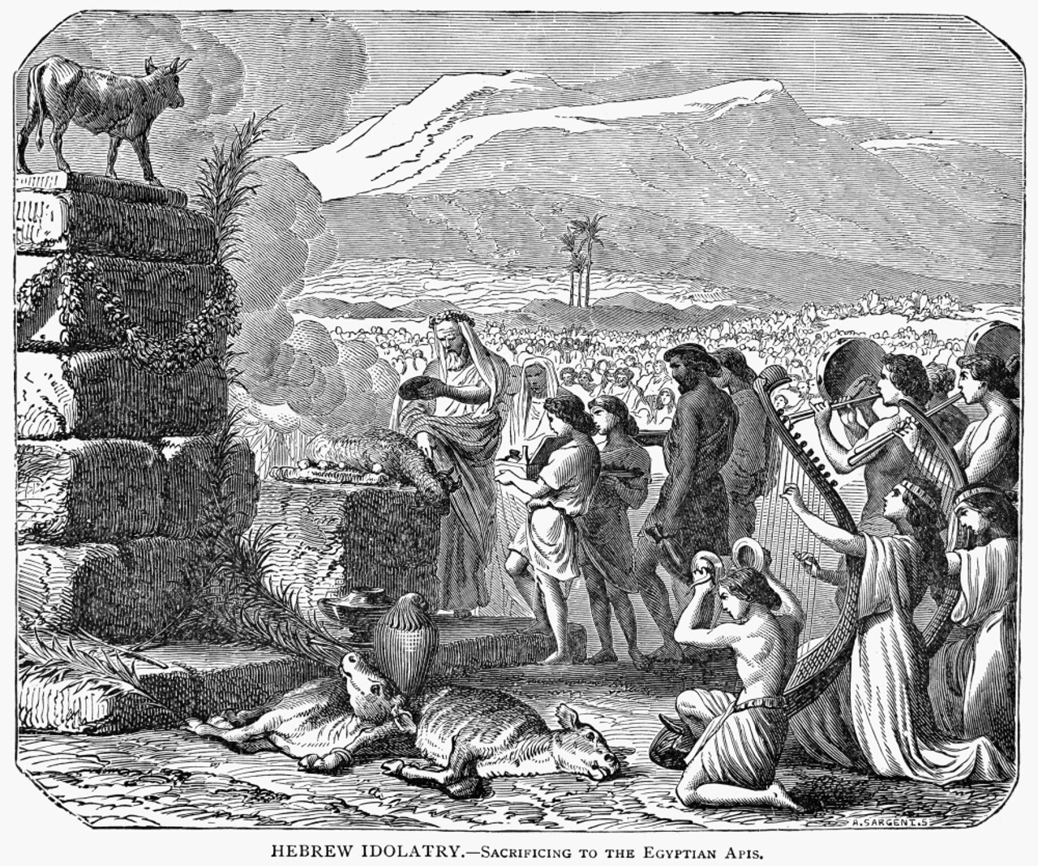
Pharaoh was a type of "Satan." Egypt was full of idolatry, the very stronghold of Satan, and a "hotbed' ofevery species of sin. Having Israel in his power Pharaoh tried to make it permanent.
Notes:
That is what Satan tries to do with the sinner. It is Satan's "taskmasters" who make the sinner sweat in hard bondage. However hard Satan's taskmasters will make us sweat, we will not give up because we know we have already won the victory in Christ Jesus.

Slide 20
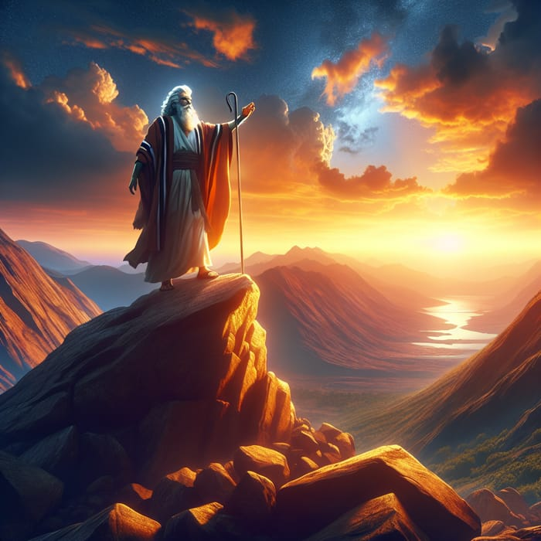
Moses was a type of Christ. Notice that God is always "beforehand" with His salvation. Salvation is no "after-thought" of God's. God was preparing Moses in the wilderness for the work he was to do in delivering Israel.

Slide 21
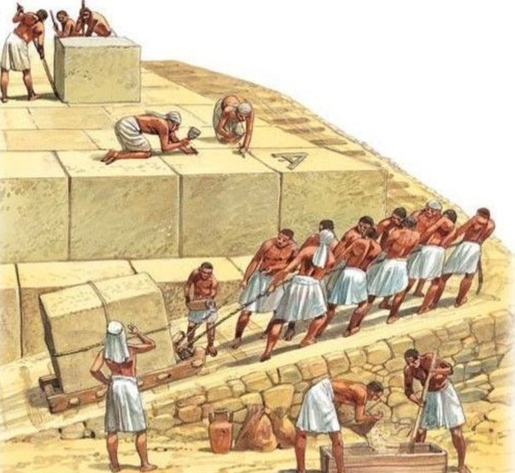
Even before Moses was born God had planned that he will deliver Israel from bondage. As the cry of the children of Israel went to God, He responded by calling Moses and telling him that this is the time to do the work that I have assigned you.

Slide 22
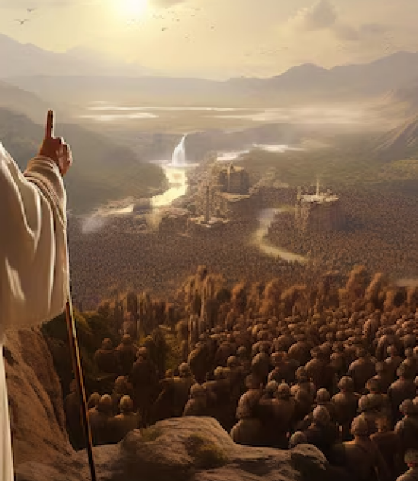
The quickest way to get relief is "'via the Throne of God. Israel phoned to God,
God phoned to Moses.
God always knows where the man needed for the occasion is. In fact, owing to His foreknowledge, He has him ready.

Slide 23
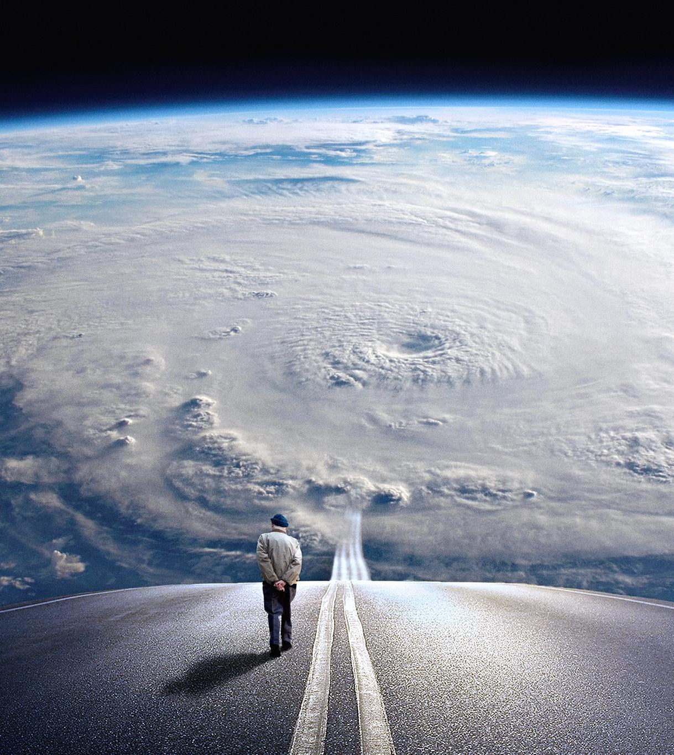
Conclusion
This world is not our home we are just passing through and we will not allow the pleasures of this world to prevent us from making it to our blessed home.
Notes:
We are homeward bound and we will not turn back. We will support each other, we will encourage each other, we will hold each other’s hand so that we can all make it together to our fatherland.

Slide 24

This world will offer many compromises to deter us from leaving, but we need to bear in mind that no compromise is worth the glories that the father has prepared for us.
Neither we nor our children will accept any of these compromises.

Slide 25

We have taken our stand with the LORD and we are not turning back. Forward ever in the LORD should be our motto.

Slide 26

I will go with my young ones for there is a feast for all of us. He who prepares a table before us in the presence of our enemies, has again prepared a table for all of us in His kingdom.

Slide 27

I cannot afford leaving any member of my nuclear family, or my church-family behind.
By the grace of God, we will pray to get everybody on board. I will go with my family, because God loves them all. I will go with my family, because Jesus’ death covers everyone of them. I will go with my family, because they are the LORD’s, just as I am His

Slide 28
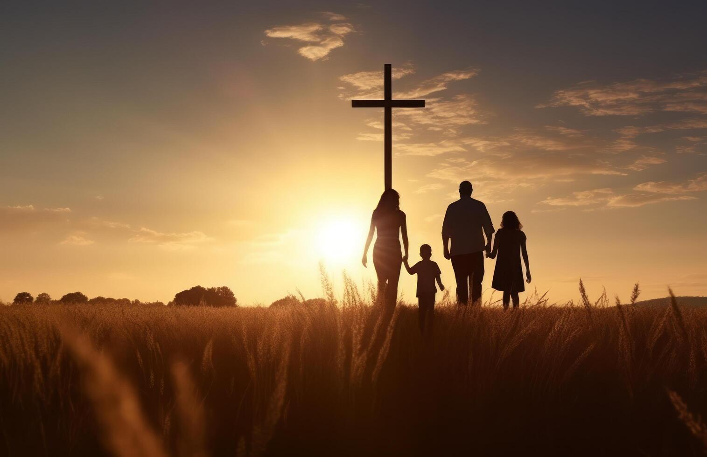
I WILL GO WITH MY FAMILY BY GOD’S GRACE

